Slide 1
UNIT 2 : Software Process Model
2.1 Waterfall Model
2.2 Prototype Model
2.3 Incremental Model
2.4 Spiral Model

Slide 2
Software Engineering : A Layered Technology
The foundation for software engineering is the process layer. Software engineering process is the glue that holds the technology layers together and enables rational(logical) and timely development of computer software.

Slide 3
Software Process Models
To solve actual problems in an industry setting, a software engineer or a team of engineers must incorporate(include) a development strategy that encompasses(cover) the process, methods, and tools layers.
This strategy is often referred to as a process model or a software engineering paradigm(model).

Slide 4
A process model for software engineering is chosen based on the nature of the project and application, the methods and tools to be used, and the controls and deliverables that are required.

Slide 5
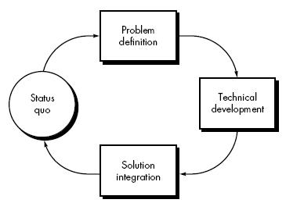
The Process

Slide 6
Process Models
Waterfall Model
Prototyping Model
Spiral Model
Incremental Model
WINWIN Spiral Model
Concurrent Development Model

Slide 7
3.1 The Waterfall Model
Also known as
  Linear Sequential Model
  Classic Life Cycle Model

Slide 8
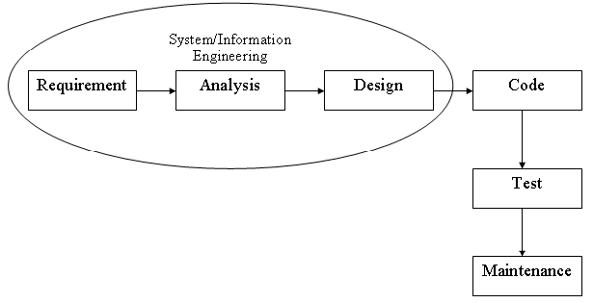

Slide 9
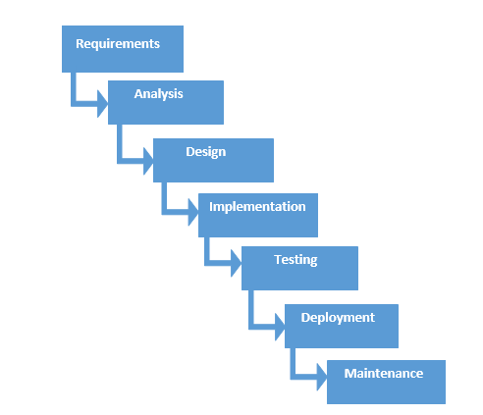

Slide 10
Requirement
Requirements are set of functionalities and constraints that the end-user (who will be using the system) expects from the system.

Slide 11
Analysis
The requirements gathering process is intensified(sharpen) and focused specifically on software. To understand the nature of the program(s) to be built, the software engineer ("analyst") must understand the information domain for the software

Slide 12
Design
System Design helps in specifying hardware and system requirements and also helps in defining overall system architecture.
The system design specifications serve as input for the next phase of the model.

Slide 13
Coding
The design must be translated into a machine-readable form. The code generation step performs this task. If design is performed in a detailed manner, code generation can be accomplished mechanistically.

Slide 14
Testing
The system is first developed in small programs called units, which are integrated(linked) in the next phase.
Each unit is developed and tested for its functionality, this is referred to as Unit Testing.
Unit testing mainly verifies if the modules/units meet their specifications.

Slide 15
Maintenance
Problems with the system developed (which are not found during the development life cycle) come up after its practical use starts, so the problem of the system are solved after development of the system.
Not all the problems come in picture directly but they arise(To display) time to time and needs to be solved, hence this process is referred as Maintenance.

Slide 16
Advantages of Waterfall Model
Documentation is produced at every stage of the waterfall model development.
This makes the understanding of the product designing procedure simpler.
After every major stage of software coding, testing is done to check the correct running of the code.
Organized approach, provides robust(strong) separation of phases.
Reflects common engineering practice.

Slide 17
Limitation of Waterfall Model
You cannot go back, if the design phase has gone wrong, things can get very complicated in the implementation phase.
Small changes or errors that arise in the completed software may cause a lot of problem.
Not all requirements are received at once, the requirements from customer goes on getting added to the list even after the end of project.

Slide 18
As the requirements of the customer goes on getting added to the list, not all the requirements are fulfilled, this results in development of almost unusable system.

Slide 19
Characteristics
Also called classic software life cycle or sequential model.
Process activities (phases/stages) are clearly separated.

Slide 20
Applicability
When requirements are well known and few changes are likely to be needed.
Can be used also for parts of larger software systems.

Slide 21
Waterfall Strengths
Easy to understand, easy to use.
Provides structure to inexperienced staff.
Milestones are well understood .
Sets requirements stability.
Good for management control (plan, staff, track).
Works well when quality is more important than Cost or schedule.

Slide 22
Use of Waterfall Model
Requirements are very well known.
Product definition is stable.
Technology is understood.
New version of an existing product.

Slide 23
3.2 The Prototyping Model
“A Prototyping Model is the system development method in which a prototype(early sample) is built, tested then reworked as necessary until an acceptable prototype is finally achieved from which the complete system or product can be developed.”
“Prototyping is becoming increasingly used for system development where rapid(speedy) development is essential”

Slide 24
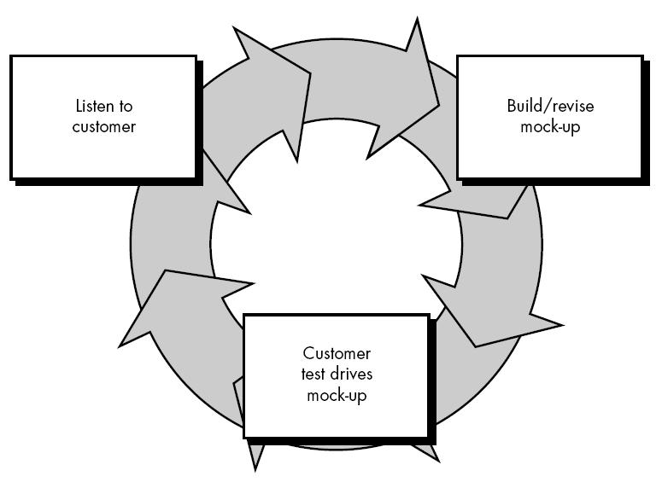

Slide 25
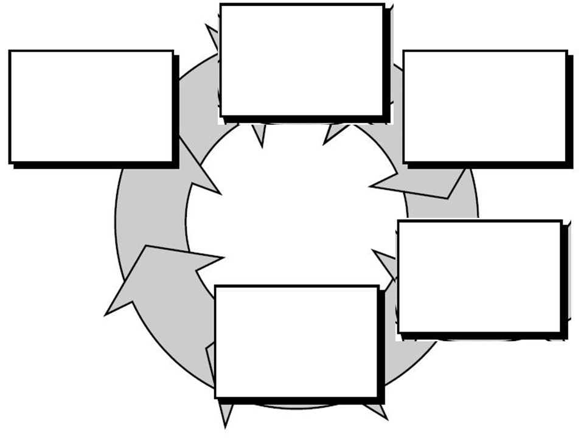
Quick Plan
Modeling Quick Design
Communications
Construction of Prototype
Deployment, Delivery & Feedback

Slide 26
Components of Prototyping Model
Communication
Quick Plan
Modeling quick design
Construction of prototype
Deployment, delivery and feedback

Slide 27
1. Communication
Prototyping model is begins with requirements.
Meet stakeholders to define the overall objectives for the software that will be visible to end user.
Define outline(profile or form) area.

Slide 28
2.Quick Plan
Make a plan for overall software which is going to be developed.
Define all the criteria which were mention in the requirements.
Highlight all the functionality of system or software.

Slide 29
3.Modeling Quick Design
It focus on all aspects which will be visible to end users.
Example:
  Human interface layout
  Output display
Quick design leads to the construction of Prototype.

Slide 30
4. Construction of Prototype
In this stage we include coding part and that time decide which technology and architecture going to be used.
Quality must be attended to :
  Usability ( use)
  Reliability (quality)
  Robustness (overcome harmful effects)
  Maintainability
  Integrity (complete)

Slide 31
  Portability (transfer easily)
  Efficiency (effective)
Taking the prototype and create whole project.

Slide 32
5.Deployment delivery and feedback
Here we will deploy our system/software
So that end user can use easily.
User provides feedback so it used for further refinement and enhancements.

Slide 33
Benefits
Improved system quality
Improved design quality
Improved maintainability
Reduced overall development effort
Misunderstanding and confusing services may be identified
The system can support user training and system testing.

Slide 34
Advantages
Strong dialogues users and developer
Missing functionality can be identified easily
Confusion and difficult function can be easily identified
Cost effective development ( Cost reduced )
Quick implementation of incomplete project requirements.

Slide 35
Increase system development speed
Helps to deliver the product with high quality easily

Slide 36
Limitation
Identifying non-functional elements difficult to document
Incomplete or inadequate(insufficient)problem analysis
Client may be unknowledgeable
Approval process and requirement is not strict
Requirements may frequently change.

Slide 37
3.3 The Spiral Model
Spiral Model is an evolutionary software process model that combines the iterative nature of prototyping with the controlled and systematic aspects of linear sequential model.
The spiral model is intented for large, expensive and complicated projects.

Slide 38
Definitions
A software life-cycle model which supposes incremental development, using the waterfall model for each step, with the aim of managing risk. In the spiral model, developers define and implement features in order of decreasing priority.

Slide 39
History of Spiral Model
The spiral model was defined by Barry Boehm in his 1986 article “A Spiral Model of Software Development and Enhancement”
This model was not the first model to discuss iterative development, but it was the first model to explain why the iteration matters
As originally envisioned, the iterations were typically 6 months to 2 years long
Each phase starts with a design goal and ends with the client reviewing the progress
Analysis and engineering efforts are applied at each phase of the project, with an eye toward the end goal of the project

Slide 40
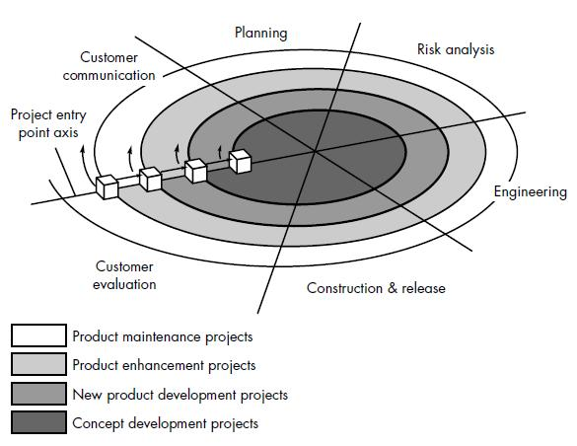

Slide 41
A spiral model is divided into a number of framework activities, also called task regions.
  Customer communication
  Planning
  Risk analysis
  Engineering
  Construction and release
  Customer evaluation

Slide 42
Spiral Model Circuits
The first circuit may result in a requirement specification
The second will result in a prototype
The next one will result in another prototype or sample of a product
The last circuit leads to a product which is suitable to be sold

Slide 43
Customer Communication
Tasks required to establish effective communication between developer and customer

Slide 44
Planning
In this phase, the objectives, alternatives and constraints of the project are determined and are documented
Tasks required to define resources, timelines, and other project related information
The objectives and other specifications(terms) are fixed in order to decide which strategies / approaches to follow during the project life cycle

Slide 45
Risk analysis
This phase is the most important part of "Spiral Model"
All possible (and available) alternatives, which can help in developing a cost effective project are analyzed and strategies are decided to use them in this phase
This phase has been added specially in order to identify and resolve all the possible risks in the project development
An analytical (logical) assessment of selected programs, to consider how to identify and eliminate risk

Slide 46
Engineering
The actual development of the project is carried out
The output of this phase is passed through all the phases iteratively in order to obtain improvements same in this phase
Tasks required to build one or more representatives of the application

Slide 47
Construction & Release
Tasks required to construct, test, install and provide user support
e.g., documentation and training
Construction is divided into iterations
Each iteration is composed of: analysis, design, implement, test
Usually, specialists say that evaluation should be 30% of the project and construction 50%

Slide 48
Customer Evaluation
Developed product is passed on to the customer in order to receive customer’s comments and suggestions
It can help in identifying and resolving possible problems/errors in the software which we have developed
This phase is very much similar to TESTING phase

Slide 49
Advantages
Introduces risk management
Prototyping control cost
Evolutionary development
Release builds for data testing
Critical high risk functions are developed first
Early and frequent feedback from users
Cumulative (increasing) costs assessed frequently

Slide 50
Disadvantages
Highly customized limiting re-usability
Applied differently for each application
Risk of not meeting budget or schedule
Lack of risk management experience
Lack of milestone
Management is doubtful (unsure) of spiral process
Complex process model

Slide 51
When to use Spiral Model
When creation of a prototype is appropriate
When costs and risk evaluation is important
For medium to high risk projects
Users are unsure of their needs
Requirements are complex
Significant changes are expected

Slide 52
Purpose of Spiral Model
Suitable for large project
  The spiral module make the developer and customer to understand better and requirement of the system
  Developer uses a prototype to reduce risk and cost
  By the increase of the spiral, the prototype becomes a real system

Slide 53
Comparison with other models
Water fall Model | Prototype Model | Spiral Model
When the customer requirements are clear and complete | When the customer requirements are not clear ambiguous or our project team is following this model with sample first | When the requirements of the customer are enthusing (Improving and extending)
Risk factor is considered in the spiral model but in water fall model it is not considered | When the requirement of the client is not clear and it is supposed to be changed. It doesn’t cover risk management | Spiral model takes special care about risk analysis. Whereas it is not given importance in prototyping model

Slide 54
3.4 The Incremental Model
Incremental build model.
The incremental build model is a method of software development where the product is designed, implemented and tested incrementally (a little more is added each time) until the product is finished.
It involves both development and maintenance.

Slide 55
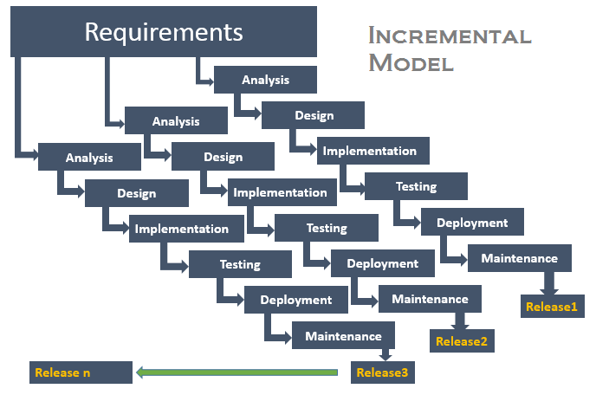

Slide 56
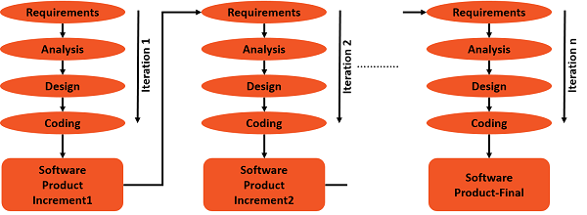

Slide 57
Strengths
You can develop prioritized requirements first.
Initial product delivery is faster.
Customers gets important functionality early.
Lowers initial delivery cost.
Each release is a product increment, so that the customer will have a working product at hand all the time.
Customer can provide feedback to each product increment, thus avoiding surprises at the end of development.
Requirements changes can be easily accommodated.

Slide 58
Weaknesses
Requires effective planning of iterations.
Requires efficient design to ensure inclusion of the required functionality and provision for changes later.
Requires early definition of a complete and fully functional system to allow the definition of increments.
Well-defined module interfaces are required, as some are developed long before others are developed.
Total cost of the complete system is not lower.

Slide 59
When to Use Iterative Incremental Model?
Most of the requirements are known up-front but are expected to evolve over time.
The requirements are prioritized.
There is a need to get the basic functionality delivered fast.
A project has lengthy development schedules.
A project has new technology.
The domain is new to the team.

